Slide 1
A Data Analysis of
Genshin Impact
Julian Carbajal, Kathy Dao, and Tiffany Le

Slide 2

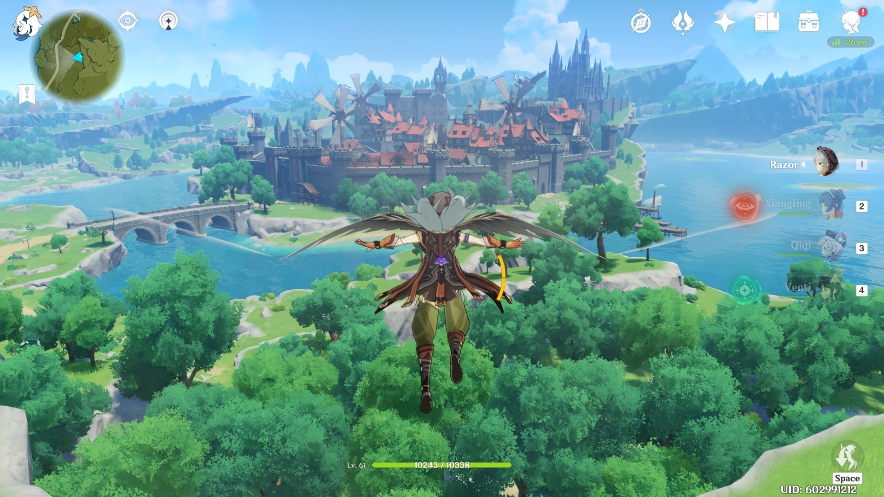
What is Genshin Impact?

Slide 3
QUESTION #1
When considering banner revenue, wish total, 5-star character summons, and average days since the last banner (amongst the 5 stars), what clusters emerge, and what characterizes those clusters?

Slide 4
Variables Involved
days_since_last_banner_1: The number of days since the last banner 1.
summons_1: The total number of summons made in banner 1.
wish_total_1: The total number of wishes made in banner 1.
days_since_last_banner_2: The number of days since the last banner 2.
summons_2: The total number of summons made in banner 2.
wish_total_2: The total number of wishes made in banner 2.
revenue: The revenue associated with the dataset.

Slide 5
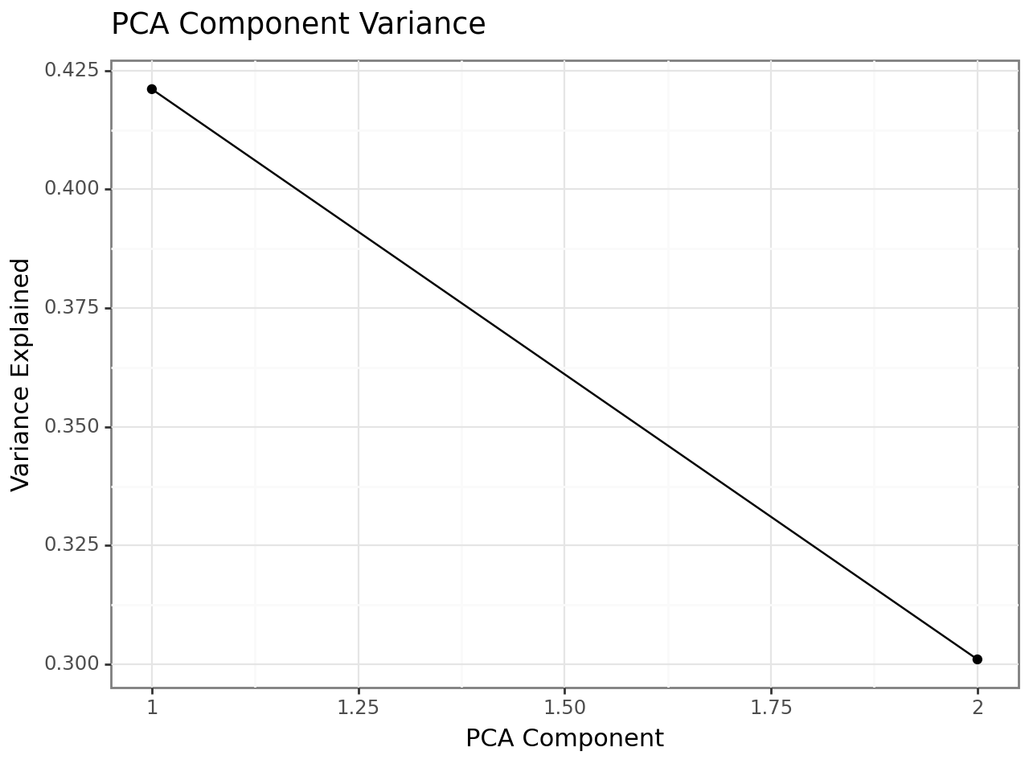
Model using PCA and K-means clustering
Silhouette Score: 0.4407438501024679
Inertia: 104.84147767268115
Silhouette Score: 0.4407438501024679
Calinski-Harabasz Index: 45.04800872170341
Davies-Bouldin Index: 0.8113118301067489
What does this mean?
The clustering results are moderately effective as there is still room to improve in terms of pre-processing, feature selection and clustering parameters.
SS: at 0.44 the silhouette score is moderate. Ideally 0.5 or above is desired.
Inertia score suggest that there's a moderate level of cluster tightness.
Calinski: moderate clustering quality
Davies: suggests reasonable cluster definition

Slide 6
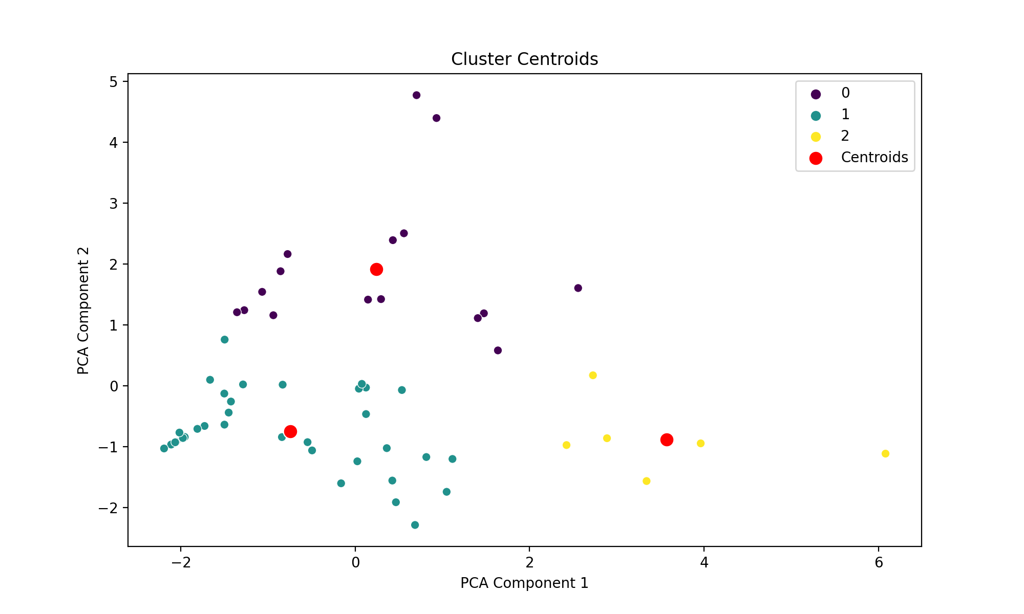
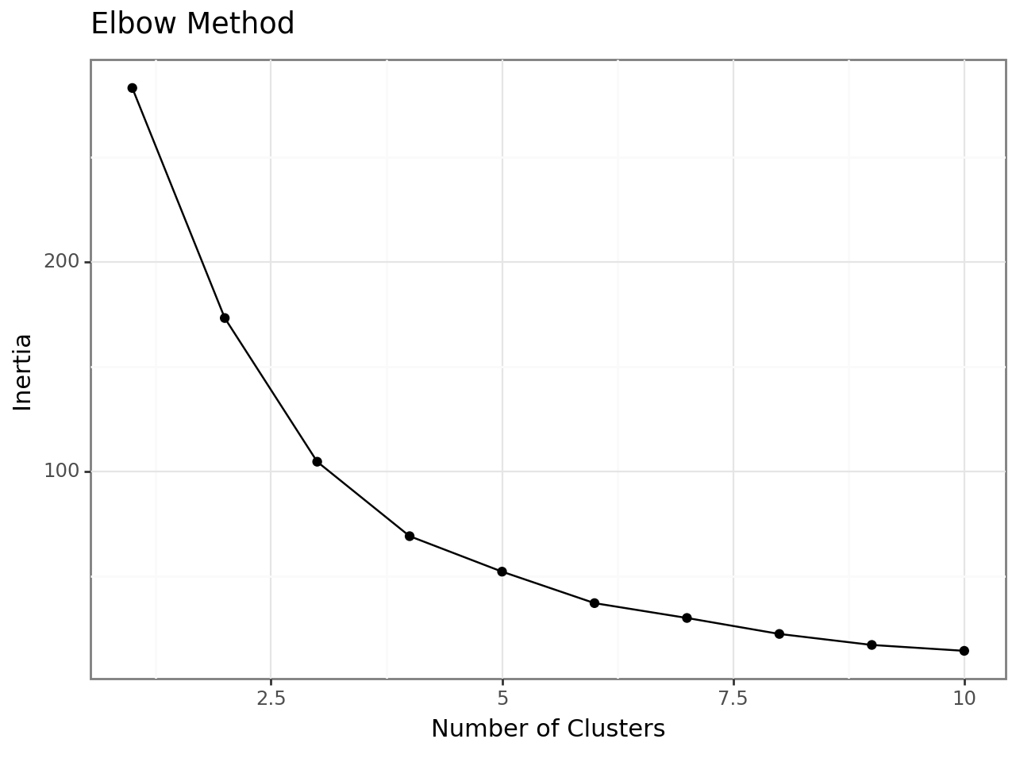
Findings (Plot #1)
clusters spread out = more diversity within clusters

Slide 7
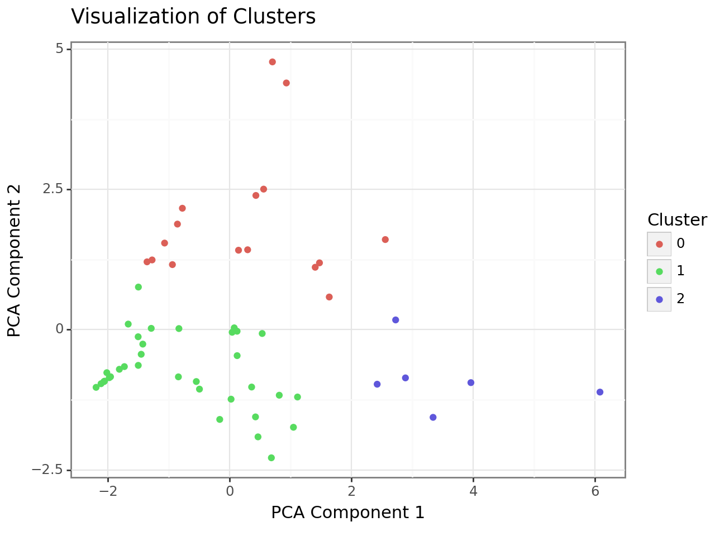
Findings (Plot #2)
The first component captures 40% of the variance while the second captures around 30%. This is good for D.R.

Slide 8
QUESTION #2
What is the impact of Banner Duration on Revenue: Does the duration of a banner have a significant impact on its total revenue?

Slide 9
Variables Involved
weapon_1: weapon type associated with 5 star char
5_star_characters_1: list of 5 star characters (most sought after)
banner_days: length of a specific banner in days.
re-run: whether the banner event came back.
wish_total: The total number of wishes made.

Slide 10
Model (Supervised ML)
Random Forest Regressor Metrics:
---------------------------------
Top 10 Feature Importances for Random Forest Regressor:
------------------------------------------------------
1. Feature: wish_total, Importance: 0.5886
2. Feature: rerun, Importance: 0.0800
3. Feature: banner_days, Importance: 0.0460
4. Feature: weapon_1_Engulfing Lightning, Importance: 0.0339
5. Feature: weapon_1_Staff of Homa, Importance: 0.0305
6. Feature: 5_star_character_1_Raiden Shogun, Importance: 0.0263
7. Feature: weapon_1_A Thousand Floating Dreams, Importance: 0.0221
8. Feature: 5_star_character_1_Nahida, Importance: 0.0202
9. Feature: weapon_1_Splendor of Tranquil Waters, Importance: 0.0130
10. Feature: weapon_1_Lost Prayer to The Sacred Winds, Importance: 0.0127
Gradient Boosting Regressor Metrics:
-------------------------------------
Top 10 Feature Importances for Gradient Boosting Regressor:
-----------------------------------------------------------
1. Feature: wish_total, Importance: 0.5961
2. Feature: rerun, Importance: 0.1280
3. Feature: weapon_1_Engulfing Lightning, Importance: 0.0669
4. Feature: 5_star_character_1_Nahida, Importance: 0.0377
5. Feature: banner_days, Importance: 0.0351
6. Feature: 5_star_character_1_Hu Tao, Importance: 0.0166
7. Feature: 5_star_character_1_Klee, Importance: 0.0125
8. Feature: 5_star_character_1_Sangonomiya Kokomi, Importance: 0.0121
9. Feature: 5_star_character_1_Albedo, Importance: 0.0111
10. Feature: weapon_1_A Thousand Floating Dreams, Importance: 0.0105

Slide 11
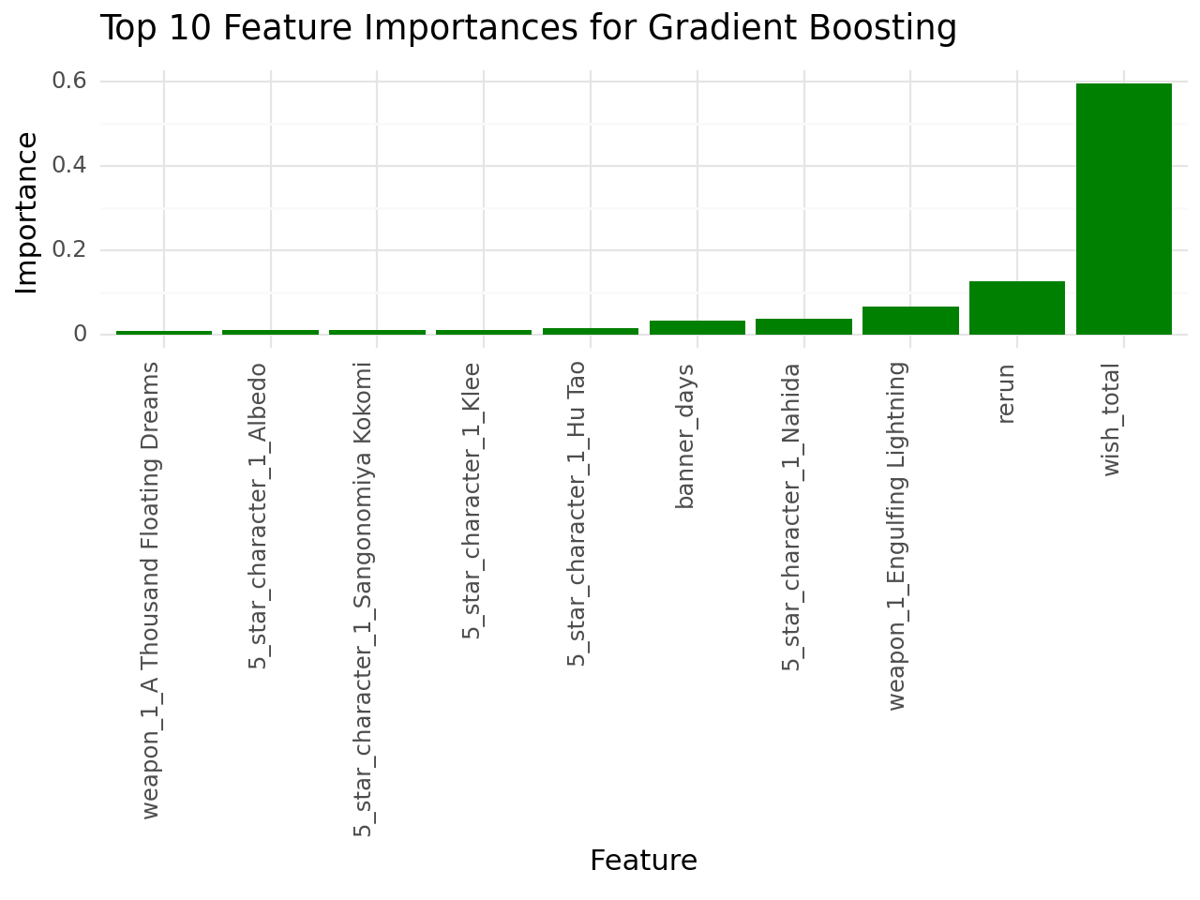
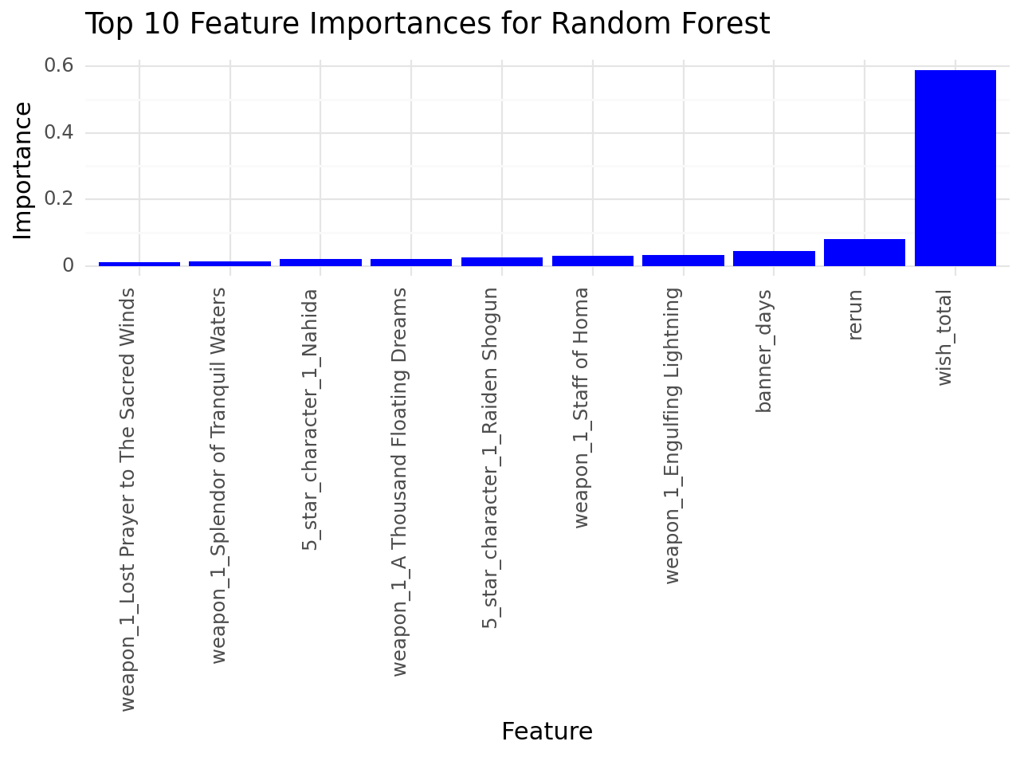
Findings (Plot #1)

Slide 12
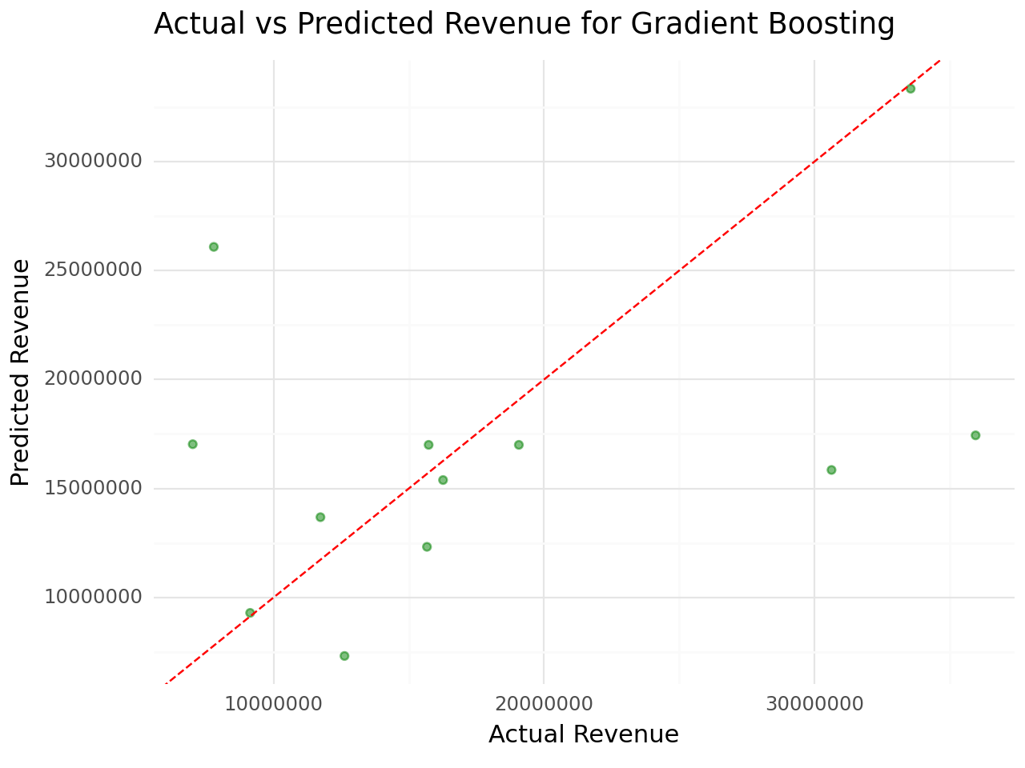
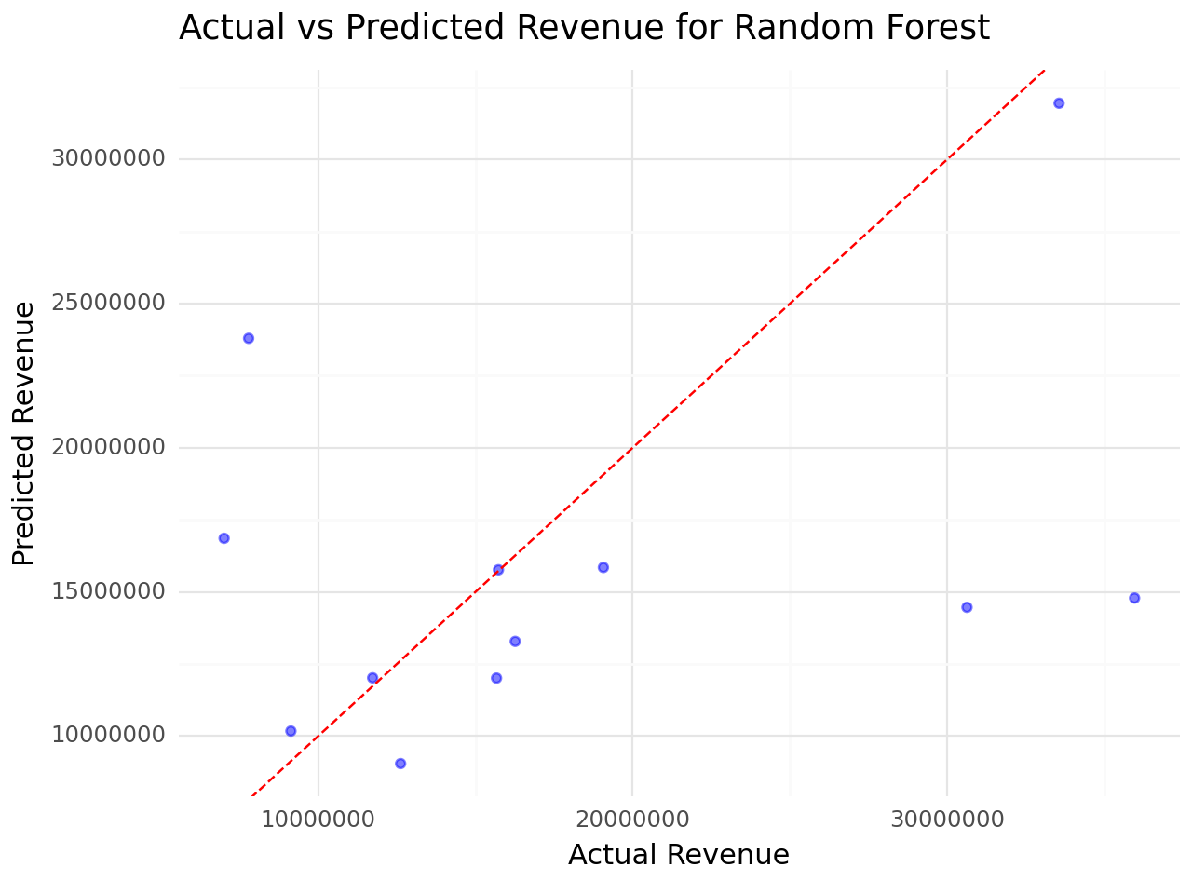
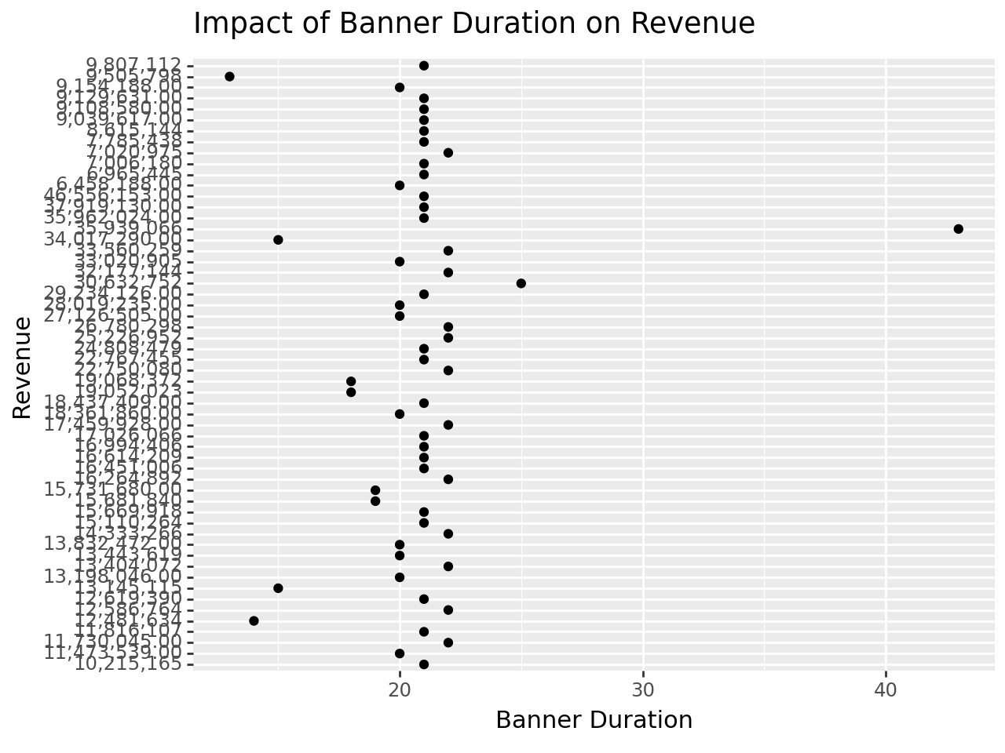
Findings (Plot #2)

Slide 13
QUESTION #3
When predicting a Character’s Rarity, which predictor “Lore-Related” features or their “Playstyle Stats” improves the Accuracy the most compared to a model with all other variables except itself?

Slide 14


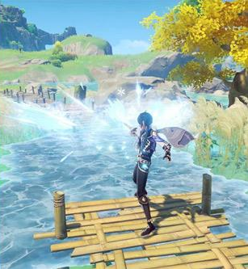

QUESTION #3
+
OR
Lore
Play Style
Character
Rarity

Slide 15
“Lore” Features
“Playstyle” Features
Gradient Boosting Classifier Model
Character Region
Elemental Power
Birthday (Zodiac) Sign
Height
Gender
Weapon Type
Team Comp Flexibility
Ascension Stat
Base HP, Atk, and Def (at max level)

Slide 16
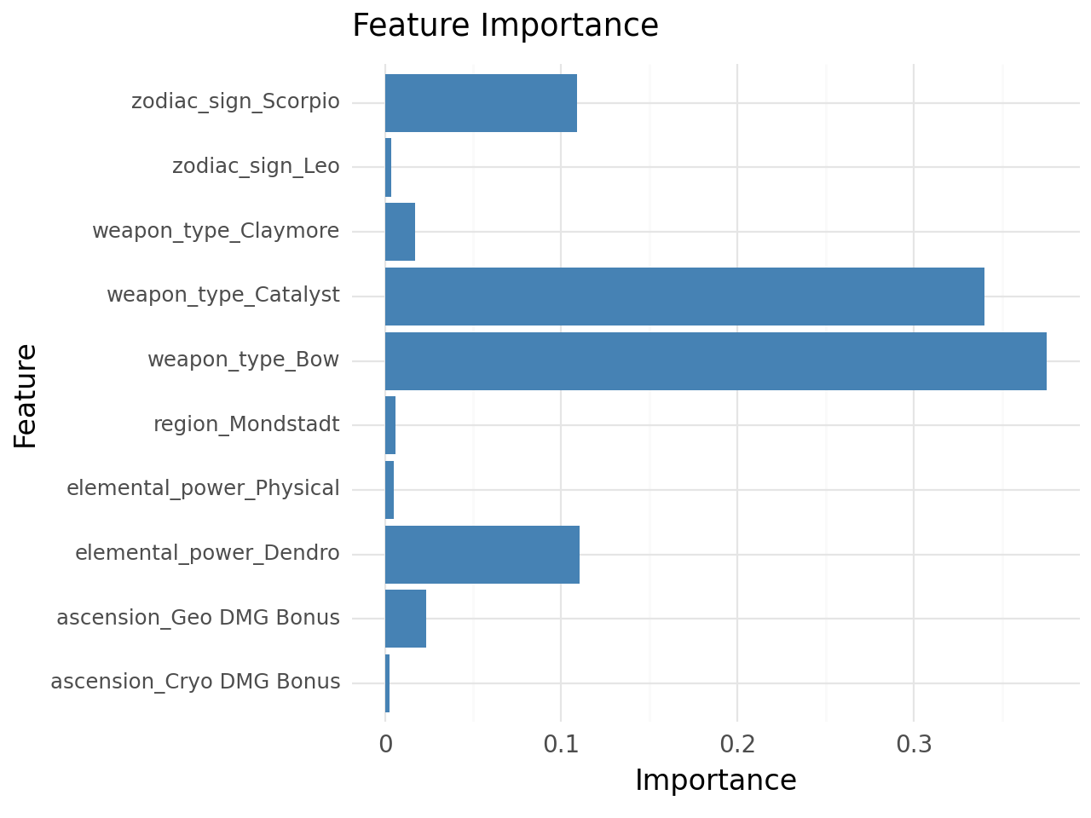
Lore
Playstyle
Lore
Playstyle

Slide 17
“Lore” Features
“Playstyle” Features
0.124135
0.758854

Slide 18
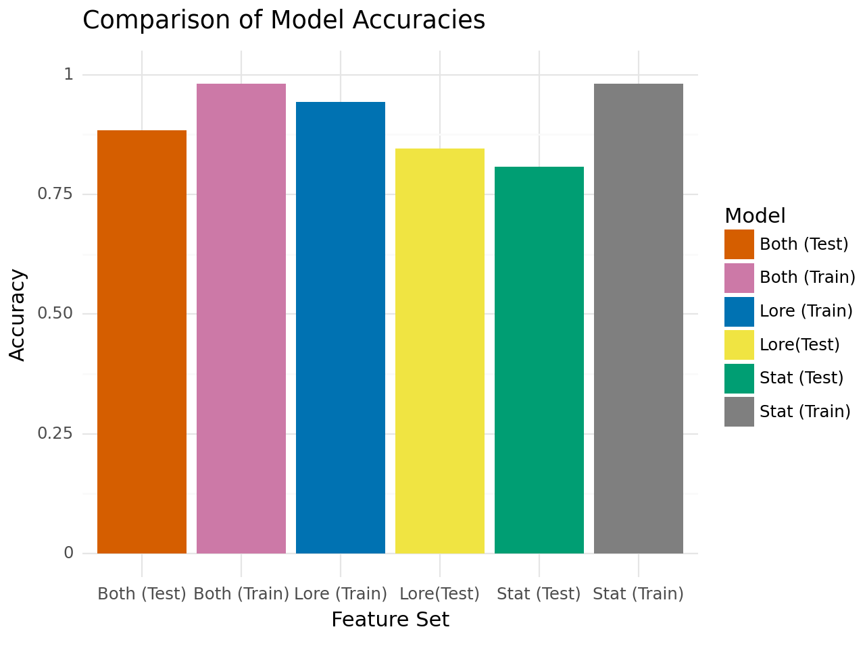

Slide 19
Model | Accuracy
Lore (Train) | 0.773585
Lore (Test) | 0.615385
Stat (Train) | 0.981132
Stat (Test) | 0.807692
Both (Train) | 0.981132
Both (Test) | 0.884615

Slide 20
QUESTION #4
Can we predict the weapon's base ATK based on their weapon type, secondary stat, rarity, obtain method, and maxed secondary stats? Which of the variables has the strongest relationship with the base ATK?

Slide 21
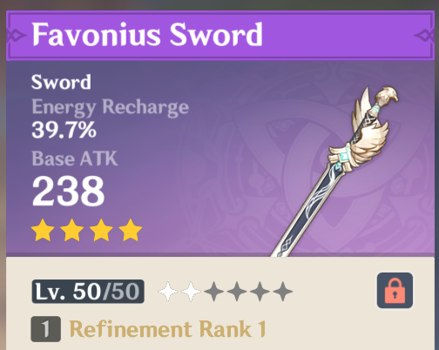
QUESTION #4

Slide 22
Variables Involved
Gradient Boosting
Regressor Model
Weapon Type
Secondary Stat
Rarity
Obtain Method
Maxed Secondary Stat

Slide 23
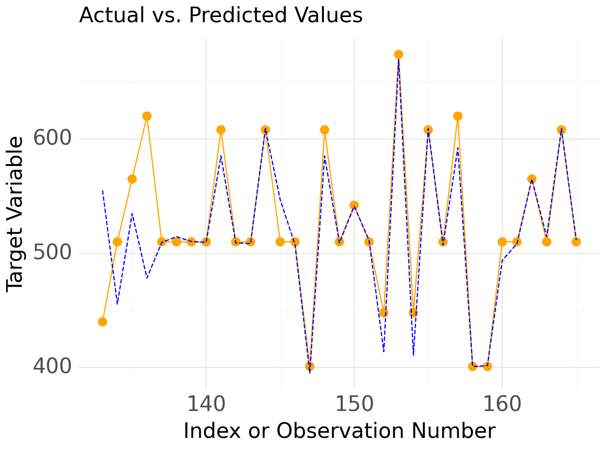
Train MSE: 69.67
Test MSE: 511.24
Train MAE: 3.34
Test MAE: 11.50
Train MAPE: 0.006
Test MAPE: 0.022
Train R2: 0.98
Test R2: 0.90

Slide 24
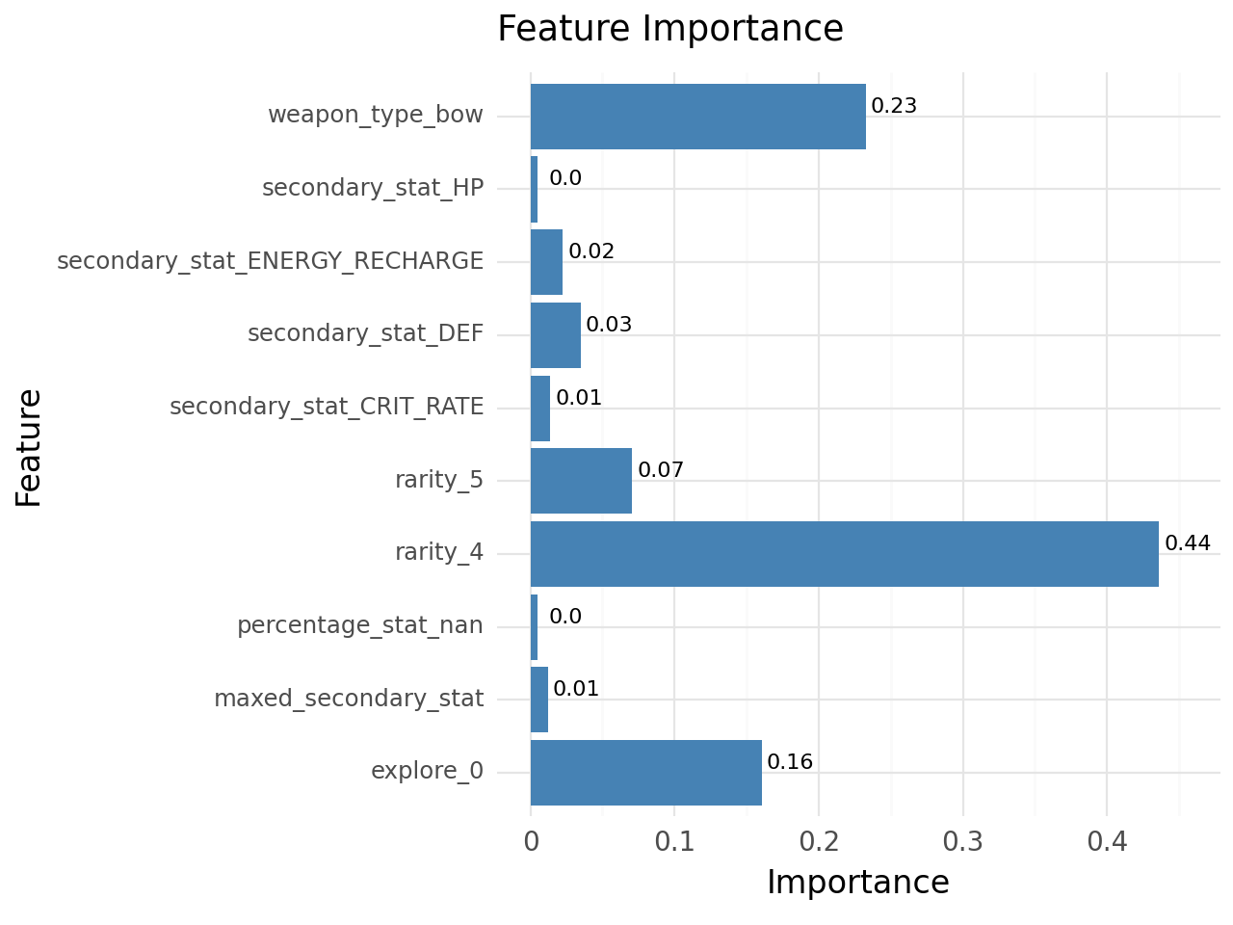

Slide 25
Feature Importance
Feature | Importance
Weapon Type | 0.23455
Secondary Stat | 0.078624
Rarity | 0.506313
Obtain Method | 0.161389
Maxed Secondary Stat | 0.012113

Slide 26
QUESTION #5
Can we identify distinct groups or patterns among characters based on their main_DPS, sub_DPS, and support_rating and do these groups exhibit different levels of flexibility?

Slide 27
Variables Involved
flexibility: a calculated average of a character’s `main_dps_rating`, `sub_dps_rating`, and `support_rating` rating; the value ranges from 0 to 1. This illustrates how flexible a character is in performing in different roles.
main_DPS_rating: : a numeric rating from 1 to 6 that defines the character’s effectiveness in a Main DPS (Damage per Second) role. The Main DPS character in the team is the primary “on-field” damage dealer.
sub_DPS_rating: a numeric rating from 1 to 6 that defines the character’s effectiveness in a Sub DPS (Damage per Second) role. The Sub DPS character in the team is an “off-field” damage dealer.
support_rating: a numeric rating from 1 to 6 that defines the character’s effectiveness in a support role. The team's Support character(s) heals, gives stat boosts, and/or shields their teammates.

Slide 28
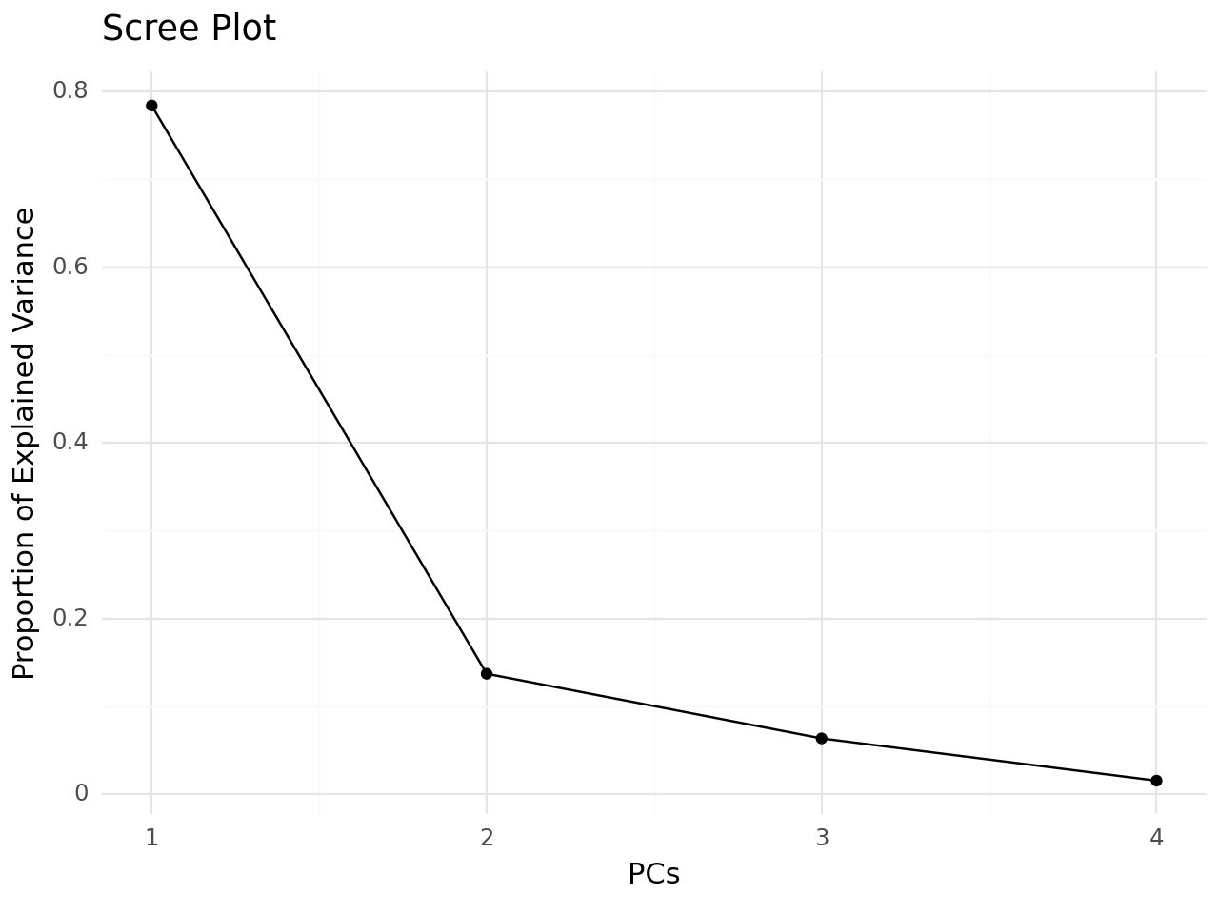
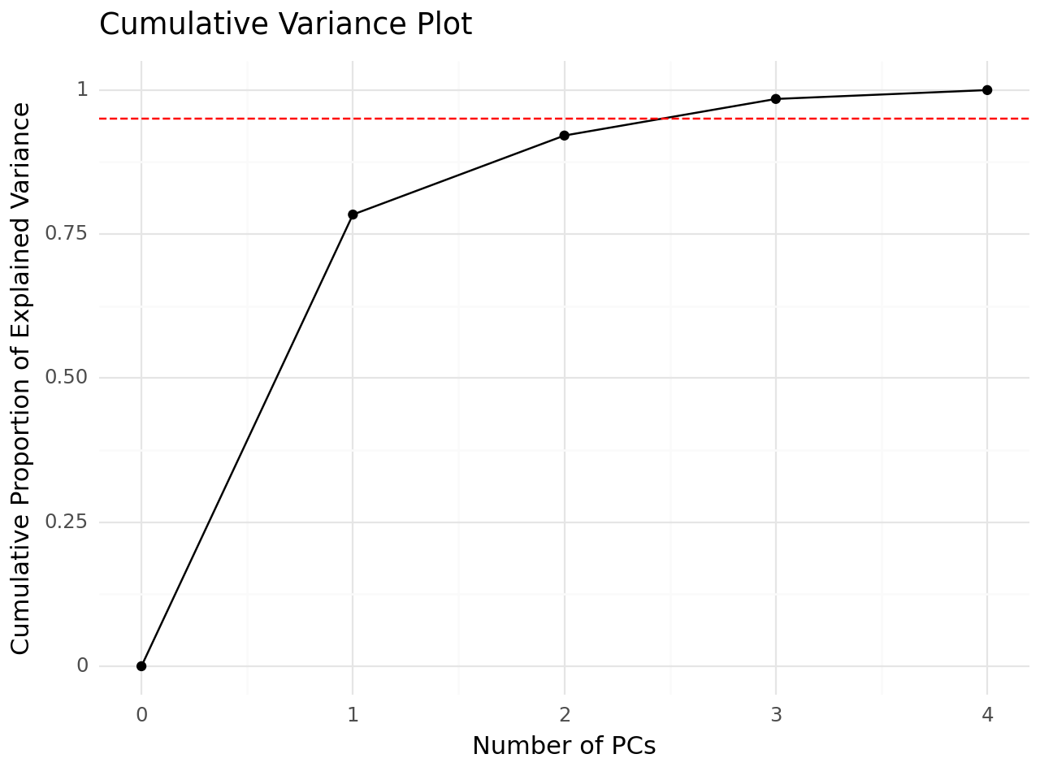

Slide 29
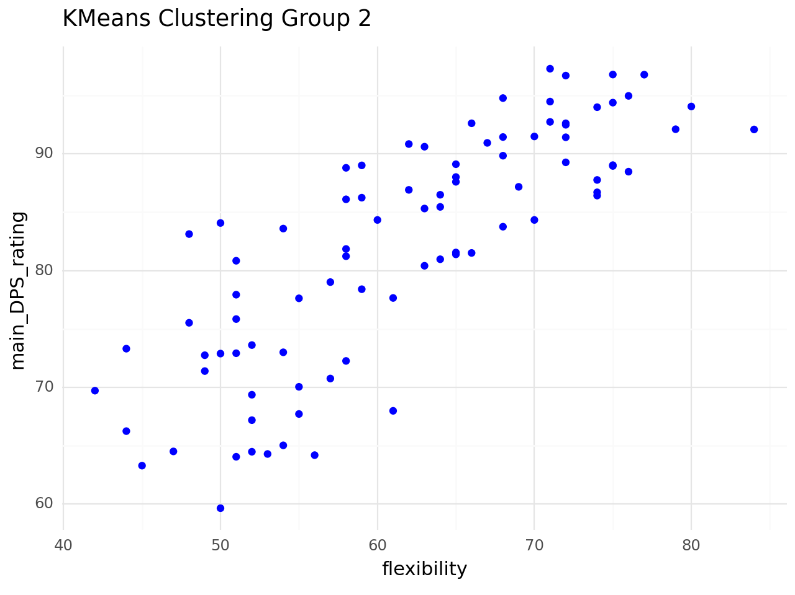
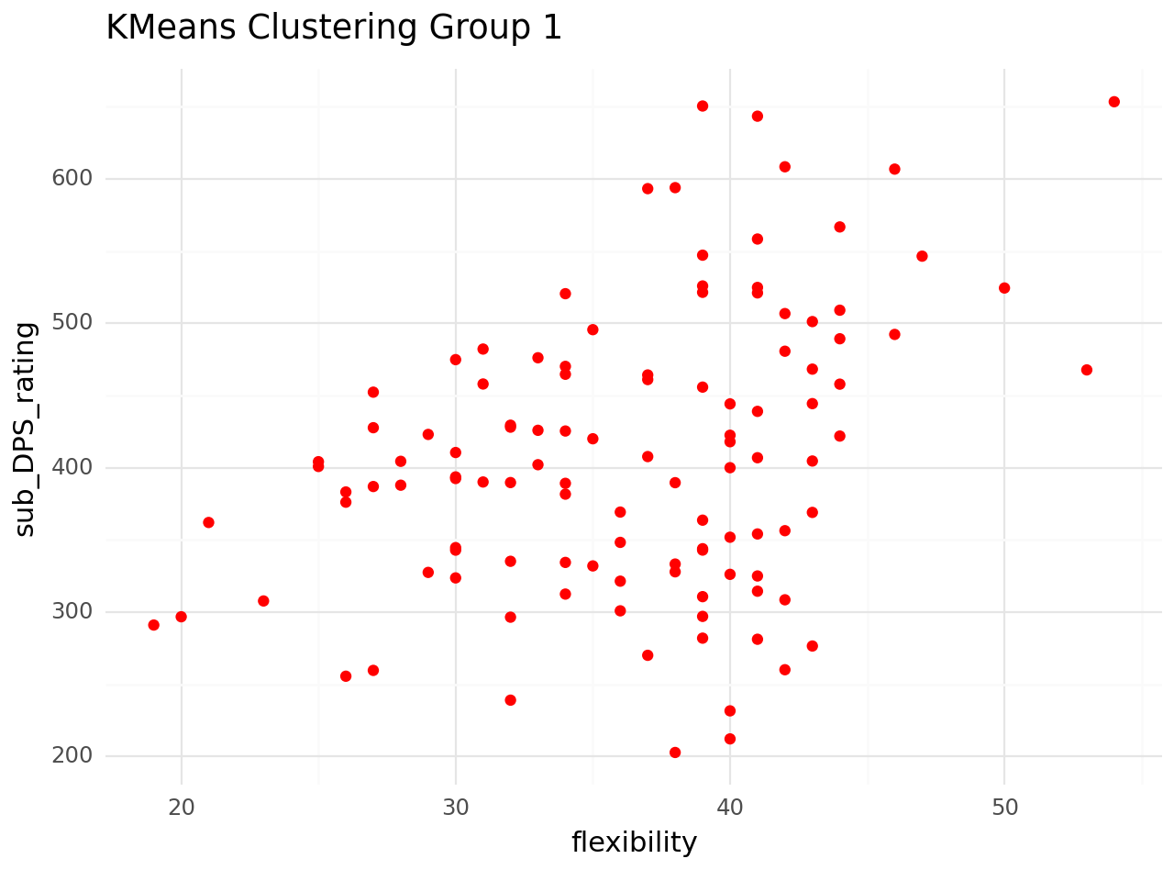
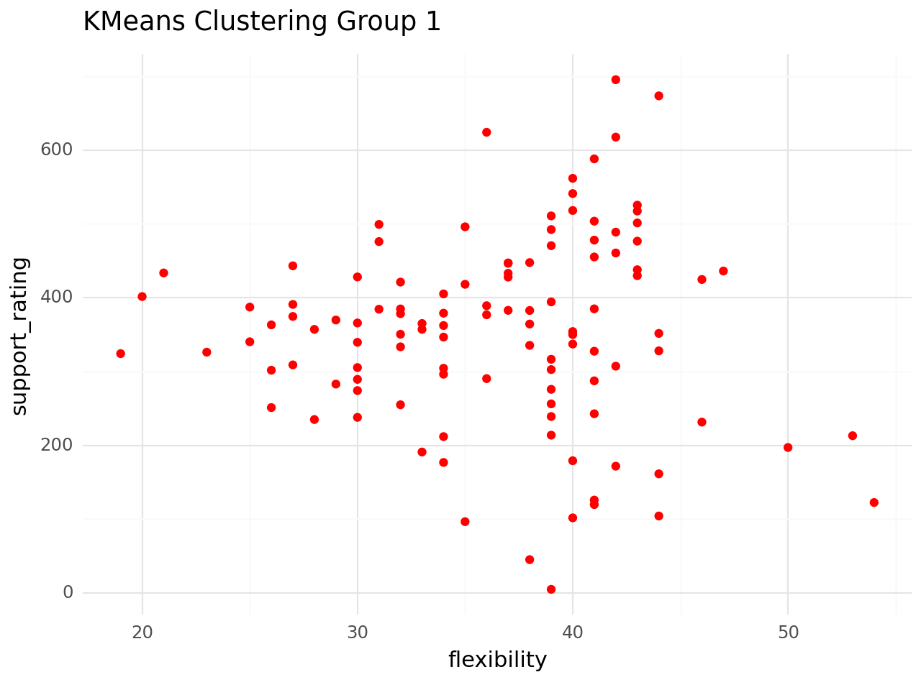

Slide 30
QUESTION #6
Using a supervised model, can we predict a character’s team flexibility based on their ascension, vision, and weapon types? What features contribute most to the model's accuracy?

Slide 31
Variables Involved
ascension_specialty: character stat that is increased when leveling up the character’s main level. The stats that can be increased are: “Anemo/Geo/Electro/Dendro/Hydro/Pyro/Cryo DMG Bonus”, “ATK”, “CRIT RATE”, “CRIT DMG”, “HP”, “Energy Recharge”, “Healing Bonus”, or “Elemental Mastery”
vision: vision/elemental power that the character can use.
weapon_type: the weapon that the character wields
rarity: rarity of the character
main_DPS_rating: a numeric rating from 1 to 6 that defines the character’s effectiveness in a Main DPS (Damage per Second) role. The Main DPS character in the team is the primary “on-field” damage dealer.
sub_DPS_rating: a numeric rating from 1 to 6 that defines the character’s effectiveness in a Sub DPS (Damage per Second) role. The Sub DPS character in the team is an “off-field” damage dealer.
support_rating: a numeric rating from 1 to 6 that defines the character’s effectiveness in a support role. The team's Support character(s) heals, gives stat boosts, and/or shields their teammates.

Slide 32
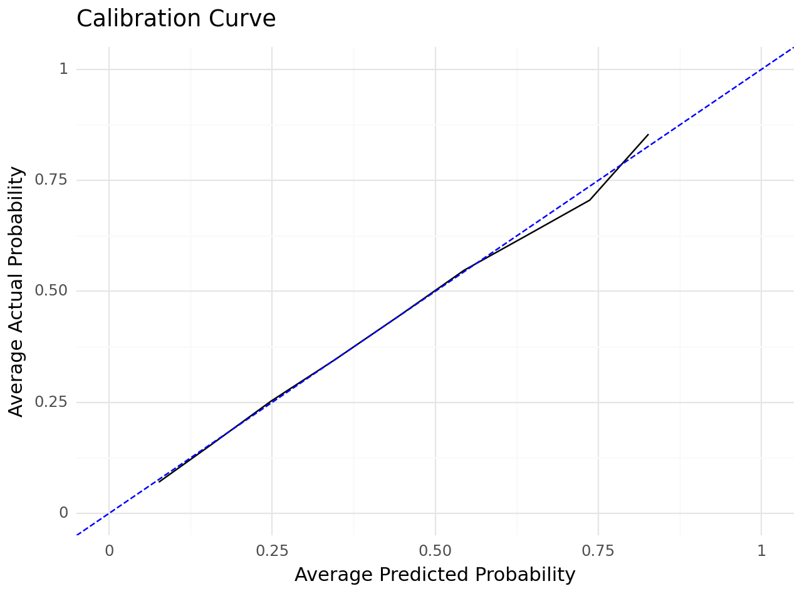
Logistic Regression Metrics (Training Set)
Accuracy: 0.7284689133887479
Recall: 0.17885551948051948
ROC AUC: 0.6951613864620101
Logistic Regression Metrics (Test Set)
Accuracy: 0.7215440792905582
Recall: 0.1807909604519774
ROC AUC: 0.7010029963665447
Logistic Regression
MSE: 0.27845592070944186
MAE: 0.27845592070944186

Slide 33
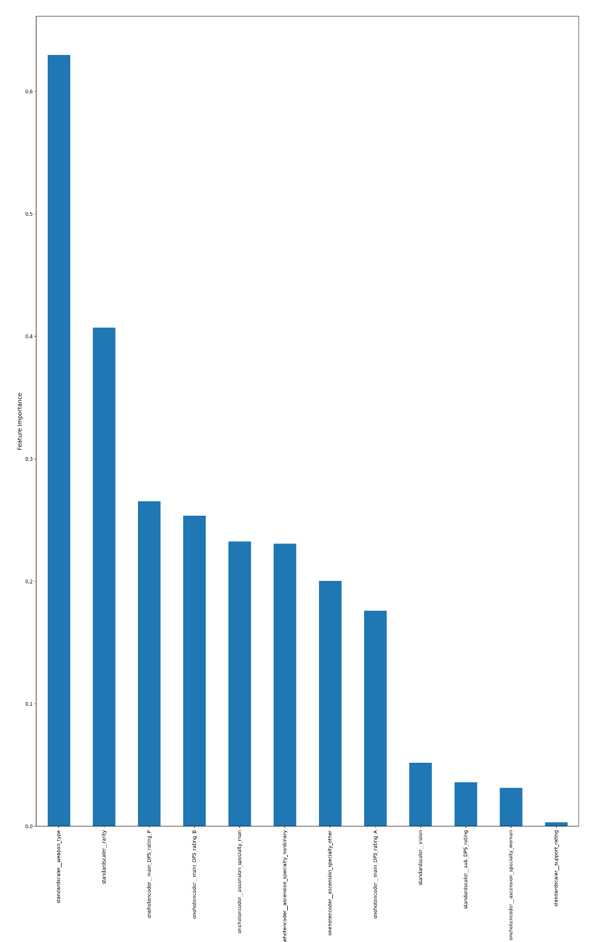
Variable | Feature Importance
weapon_type | 0.629699
rarity | 0.407155
main_DPS_rating_P | 0.265181
main_DPS_rating_B | 0.253485
ascension_specialty_man | 0.232406
ascension_specialty_nonbinary | 0.230647
ascension_specialty_other | 0.200226
main_DPS_rating_A | 0.176087
vision | 0.051918
sub_DPS_rating | 0.036026
ascension_specialty_woman | 0.031474
support_rating | 0.003157

Slide 34
Thank You!

